Slide 1

Mobile design mobile programming and multimedia M.Sc. in Computer Science 2023/2024 Michael Amista’ (2122865) Sebastiano Sanson (2130917)

Slide 2
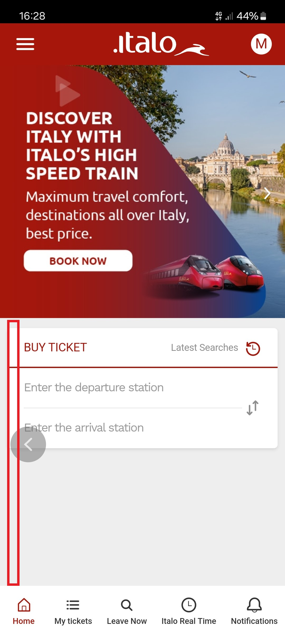
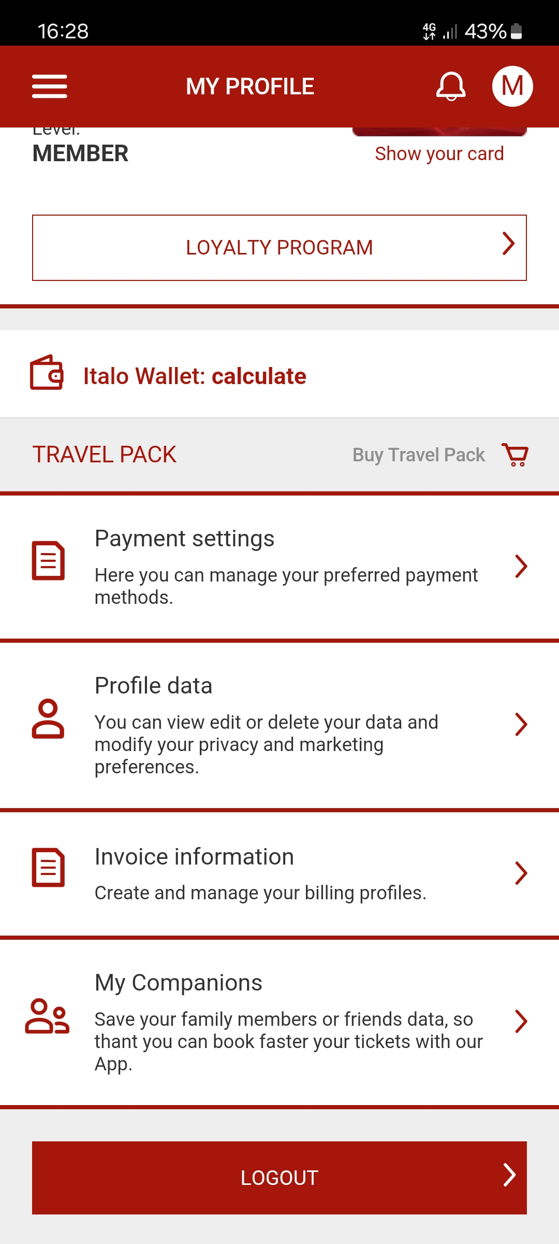
NEGATIVE DESIGN: ITALO
Main problems:
carousel management
conflict with OS gestures
loss of the bottom menu in internal pages
dangerous operations in the comfort zone
Some solutions:
provide carousel information using another approach
delete problematic gestures
include the bottom menu on all pages
move dangerous operations outside the comfort zone

Slide 3
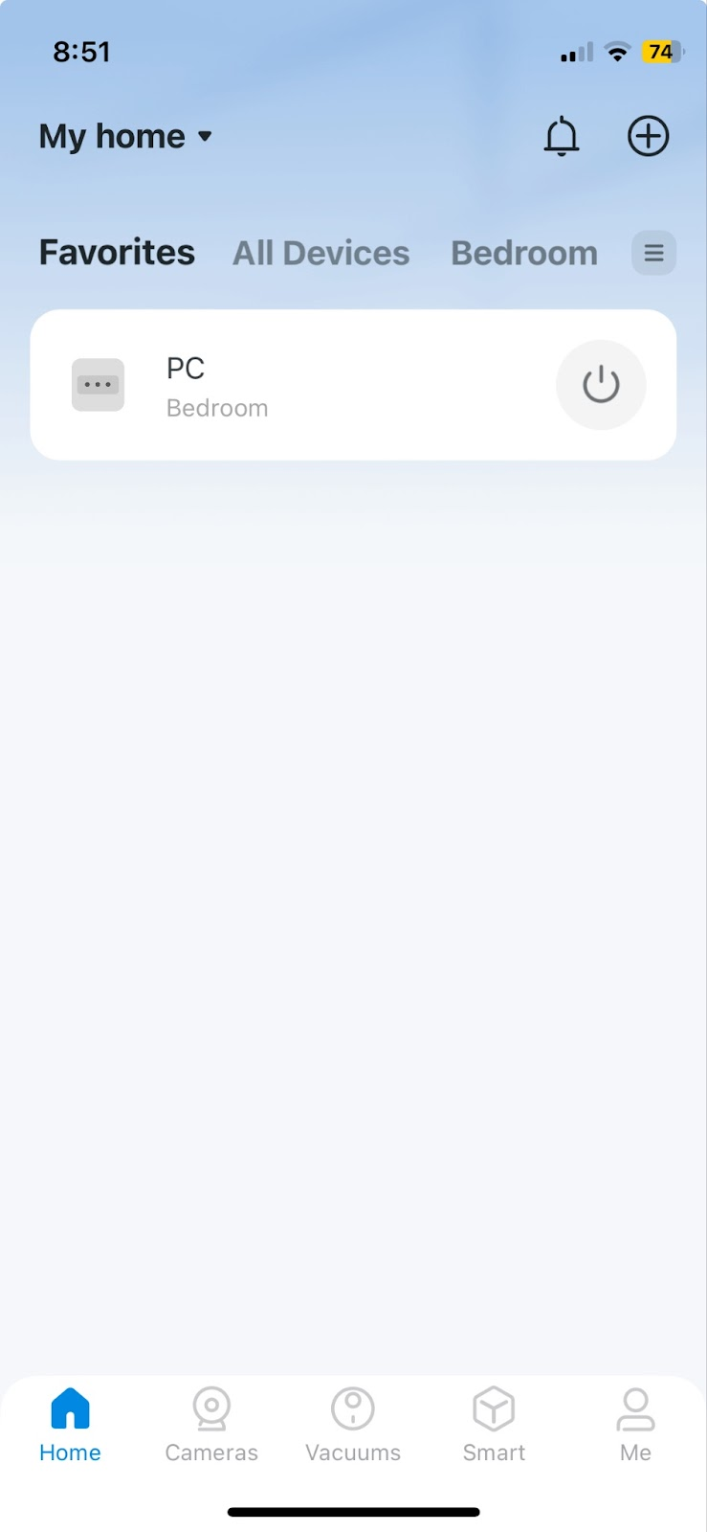
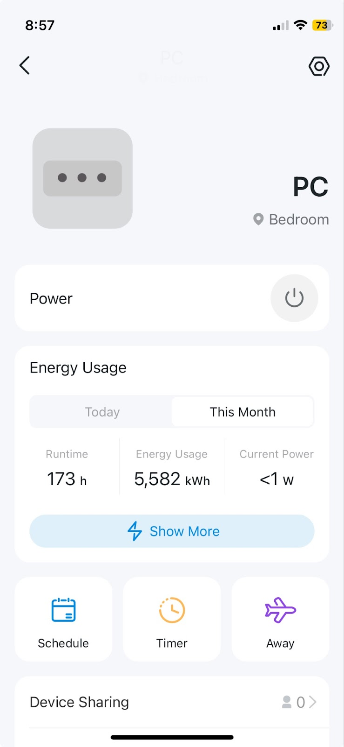
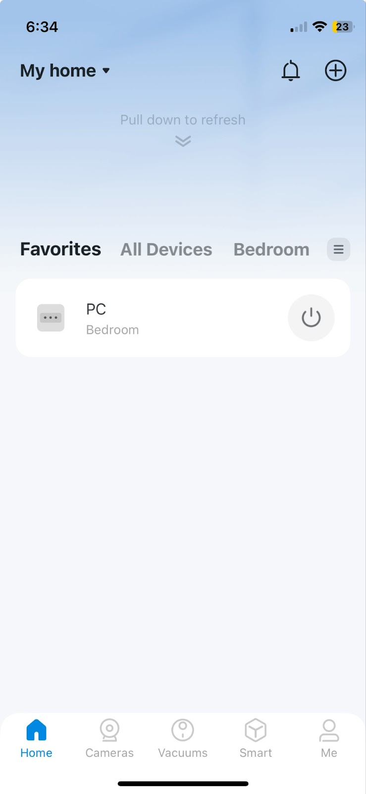
POSITIVE DESIGN: TAPO
Positive aspects:
follows the principle: “content on top”
tool bar on the bottom (following iOS guidelines)
just-in-time interfaces
gestures

